Slide 1
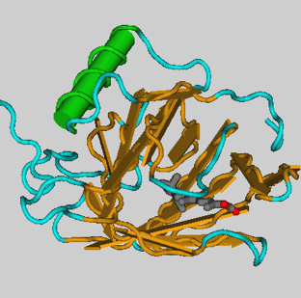
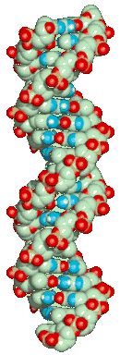
DNA
RNA
protein
Phenotype
cDNA
[1] Transcription
[2] RNA processing (splicing)
[3] RNA export
[4] RNA surveillance
1

Slide 2
Gene Identification
Given a genome
Figure out what parts do what
What are the rules?
What changes what?
Under what circumstances?
What changes the rules?
How? Why?
Gene Identification involves:
Locating genes within long segments of genomic sequence.
Demarcating the initiation and termination sites of genes.
Extracting the relevant coding region of each gene.
Identifying a putative function for the coding region.

Slide 3
Outline of Session
Quick review of genes, transcription and translation
Gene finding in prokaryotes
Some prokaryotic gene finders
Improving on ORF finding
Gene finding in eukaryotes
Some eukaryotic gene finders

Slide 4
Defining the Gene
What is the unit we call a gene?
A region of the genome that codes for a functional component such as an RNA or protein.
We'll focus on protein-coding genes for the remainder of this session.
A gene can be further divided into sequence elements with specific functions.
Genes are regulated and expressed as a result of interactions between sequence elements and the products of other genes.

Slide 5
Schematic representation of a gene

Slide 6
Finding Genes in Genomes
Gene = Coding region
What defines a coding region?
A coding region is the region of the gene that will be translated into protein sequence.
Is there such a thing as a canonical coding region?
Objective: Identify coding regions computationally
from raw genomic sequence data.

Slide 7
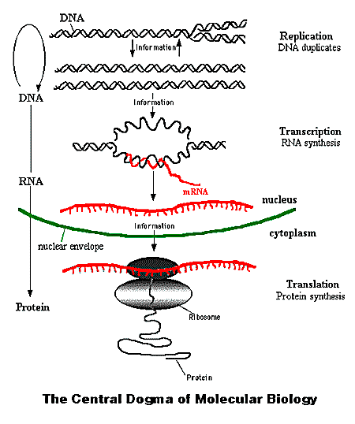
Coding Regions as Translation Regions
Translation utilizes a trinucleotide coding system: codons.
Translation begins at a start codon.
Translation ends at a stop codon.

Slide 8
Some Important Codons
Most organisms use ATG as a start codon.
A few bacteria also GTG and TTG
Regardless of codon used, the first amino acid in every translated peptide chain is methionine.
However, in most proteins, this methionine is cleaved in later processing.
So not all proteins have a methionine at the start.
Almost all organisms use TAG, TGA and TAA as stop codons.
The major exception are the mycoplasmas.

Slide 9
The Degenerate Code
Of the other 60 triplet combinations, multiple codons may encode the same amino acid.
E.g. TTT and TTC both encode phenylalanine
Organisms preferentially use some codons over others.
This is known as codon usage bias.
The age of a gene can be determined in part by the codons it contains.
Older genes have more consistent codon usage than genes that have arrived recently in a genome.

Slide 10
Identifying Genes in Genomes
Organisms utilize a variety of mechanisms to control the transcription and expression of their genes.
Manipulating gene structure is one such method of control.
Coding regions can be in contiguous segments, or
They may be divided by non-coding regions that can be selectively processed.

Slide 11
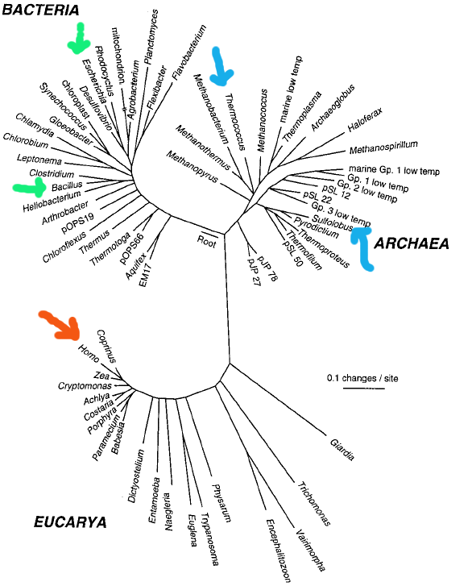
Understanding the Tree of Life
There are three major branches of the tree:
Bacteria (prokaryote)
Archaea (prokaryote)
Eukaryotes
(This is one type of Phylogenetic tree >>>>>)

Slide 12

Coding Regions in Prokaryotes
In bacteria and archaea, the coding region is in one continuous sequence known as an open reading frame (ORF).

Slide 13
Coding Regions in Prokaryotes
DNA:
ATG-GAA-GAG-CAC-CAA-GTC-CGA-TAG
Protein:
MET-GLU- GLU -HIS -GLN-VAL-ARG-Stop

Slide 14
Some Gene Finders in Prokaryotes*
Because the translation region is contiguous in prokaryotes, gene finding focuses primarily on identifying ORFs.
ORF-finder takes a syntactic approach to identifying putative coding regions.
ORF-finder is available from NCBI.
GLIMMER 2.0 is a more sophisticated program that attempts to model codon usage, average gene length and other features before identifying putative coding regions.
GLIMMER 2.0 is available from TIGR.
*Few more softwares in this category we have already discussed during the classes

Slide 15
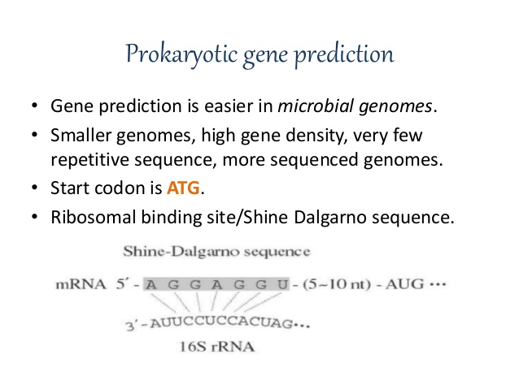

Slide 16
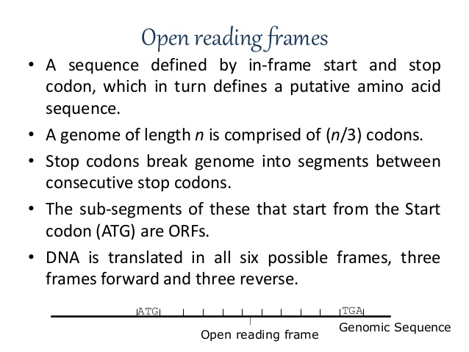

Slide 17
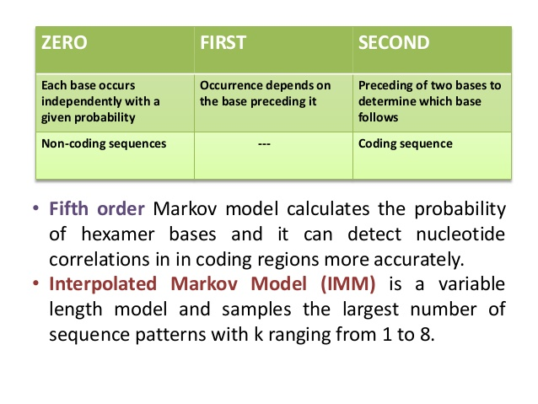

Slide 18
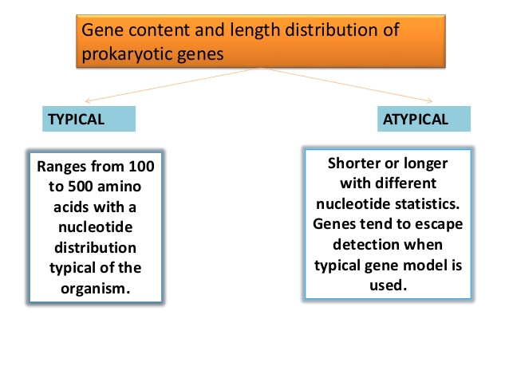

Slide 19
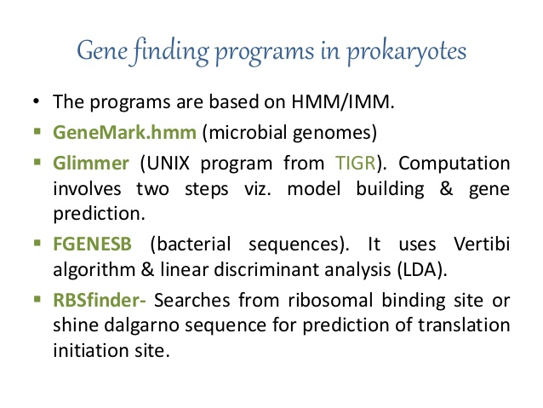

Slide 20
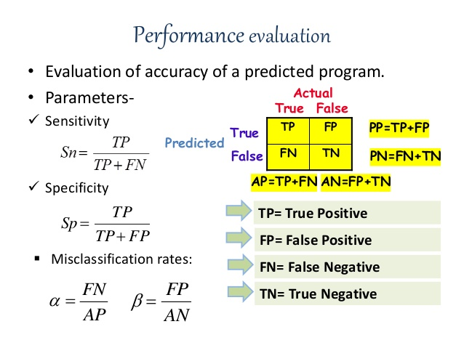
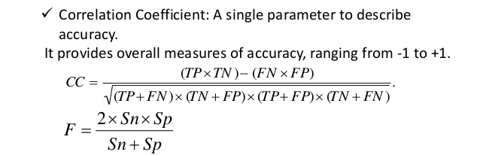

Slide 21
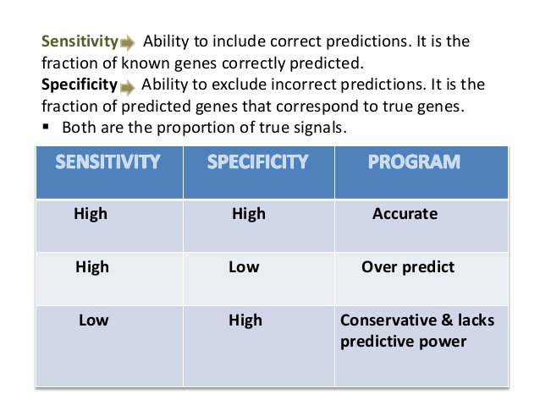

Slide 22
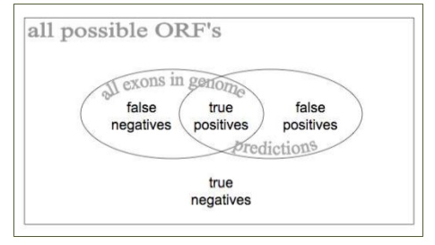

Slide 23
ORF-Finder
Approach
Identify every stop codon in the genomic sequence.
Scan upstream to the farthest, in-frame start codon.
Will locate ORFs that begin with ATG as well as GTG and TTG
Label this an ORF.
Output
List all ORFs that exceed a minimum length constraint.

Slide 24
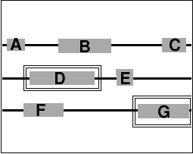
ORF-Finder
The black lines represent each of the three reading frames possible on one strand of DNA.
The gray boxes each represent a putative ORF.

Slide 25
ORF-Finder
Advantages
Can identify every possible ORF.
Minimum length constraint ensures that many false positives are discarded prior to human review.
Disadvantages
Does not eliminate overlapping ORFs.
Even with a length constraint, there are often many false positives.
Cannot take into account organism-specific idiosyncrasies

Slide 26
ORF-Finder Example
In this example, there are seven possible ORFs.
However, only ORF D and G are likely to be coding.
The others may be eliminated because they are:
Too small
ORFs A, C and E
Overlap with other ORFs,
ORFs B, C and F
Have extremely unusual codon composition.

Slide 27
Glimmer 2.0
Approach
Build an Interpolated Markov Model (IMM) of the canonical gene from a set of known genes for the organism of interest.
The model includes information about:
Average length of coding region
Codon usage bias (which codons are preferentially used)
Evaluates the frequency of occurrence of higher order combinations of nucleotides from 2 through 8 nucleotide combinations.

Slide 28
Glimmer 2.0
Output
For each ORF, GLIMMER assigns a likelihood score or probability that the ORF resembles a known gene.
High scoring ORFs that overlap significantly with other high scoring ORFs are reported but highlighted.
GLIMMER 2.0 is reported to be 98% accurate on prokaryotic genomes.

Slide 29
Glimmer 2.0
Advantages:
Fewer false positives because ORFs are evaluated for likelihood of coding.
Organism-specific because model is built on known genes.
User can modify many parameters during search phase.
Disadvantages:
Requires approximately 500+ known genes for proper training.
Genuine coding regions with unusual codon composition will be eliminated.
Reported accuracy difficult to reproduce.

Slide 30
Other features of prokaryotic genes
While the ORF is the defining feature of the coding region, there are other features we can use to identify true coding regions.
We can improve accuracy by:
Identifying control regions
Promoters
Ribosome binding sites
Characterizing composition
CpG islands
Codon usage

Slide 31
Schematic of a gene

Slide 32
Characterizing Promoters
A promoter is the DNA region upstream of a gene that regulates its expression.
Proteins known as transcription factors bind to promoter sequences.
Promoter sequences tend to be conserved sequences (strings) with variable length linker regions.
Ab initio identification of promoters is difficult computationally.
A database of known, experimentally characterized promoters is available however.

Slide 33
Ribosome binding sites
The ribosome binding site (RBS) determines, in part, the efficiency with which a transcript is translated.
Ribosome binding sites in prokaryotes are relatively short, conserved sequences and have been characterized to some extent.
Eukaryotic ribosome binding sites are more variable and not as well characterized.
They may also not be conserved from one organism to another.

Slide 34
Characterizing composition
Codon usage (preferential use of certain codons over others) can be modelled given sufficient data on known genes.
This is part of Glimmer's approach to gene identification.
Gene rich regions of the genome tend to be associated with CpG islands.
Regions high in G+C content
Multiple occurrences of CG dinucleotides.
These can be modelled as well.

Slide 35
Summary: Prokaryote Gene Finding
Prokaryotic coding regions are in one contiguous block known as an open reading frame (ORF).
Identifying an ORF is just the first step in gene finding.
The challenge is to discriminate between true coding regions and non-coding ORFs.
Using information from promoter analysis, RBS identification and codon usage can facilitate this process.

Slide 36
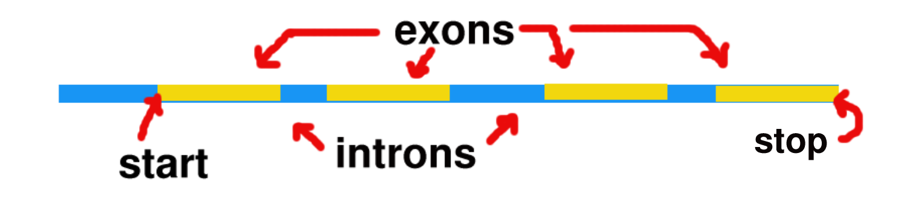
Coding Regions in Eukaryotes
In eukaryotes, the coding regions are not always in one block.

Slide 37
Coding Regions in Eukaryotes
DNA:
ATG-GAA-GAG-CAC-
*GTTAACACTACGCATACAG*
-CAA-GTC-CGA-TAG
Protein:
MET-GLU-GLU-HIS-GLN-VAL-ARG-Stop

Slide 38
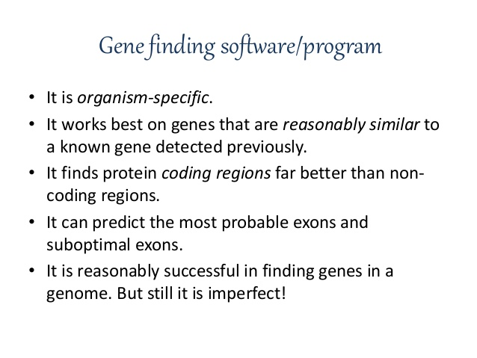

Slide 39
Gene Finders in Eukaryotes*
Tools for finding genes in eukaryotes
Genie uses information from known genes to guess what regions of the genome are likely to contain new genes.
Fgenes is very good at finding exons and reasonably accurate at determining gene structure.
Genscan is one of the most sophisticated and most accurate.
*Few more softwares in this category we have already discussed during the classes

Slide 40
Genie
Approach
Apply a pre-built Generalized Hidden Markov Model (GHMM) of the canonical eukaryotic (mammalian) gene.
The model includes information about:
Average length of exons and introns.
Compositional information about exons and introns.
A neural-net derived model of splice junctions and consensus sequences around splice junctions.
Splice junction information can be further improved by including results of homology searches.

Slide 41
Genie
Output
Likelihood scores for individual exons
The set of exons predicted to be associated with any given coding region.
Information regarding alignment of the predicted coding region to known proteins from homology searching.
Genie is approximately 60-75% accurate on eukaryotic genomes.

Slide 42
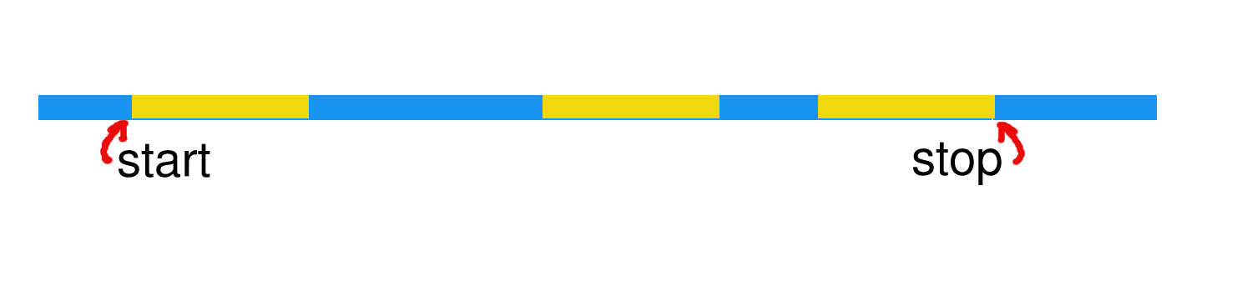
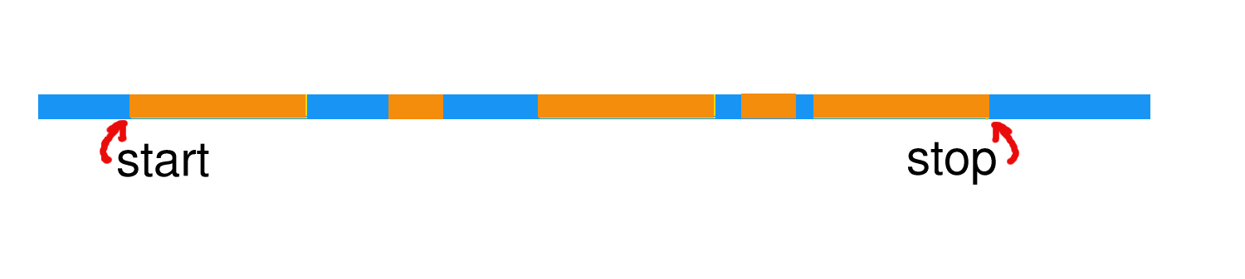
Genie Example
Actual gene structure:
Initial Prediction by Genie:

Slide 43
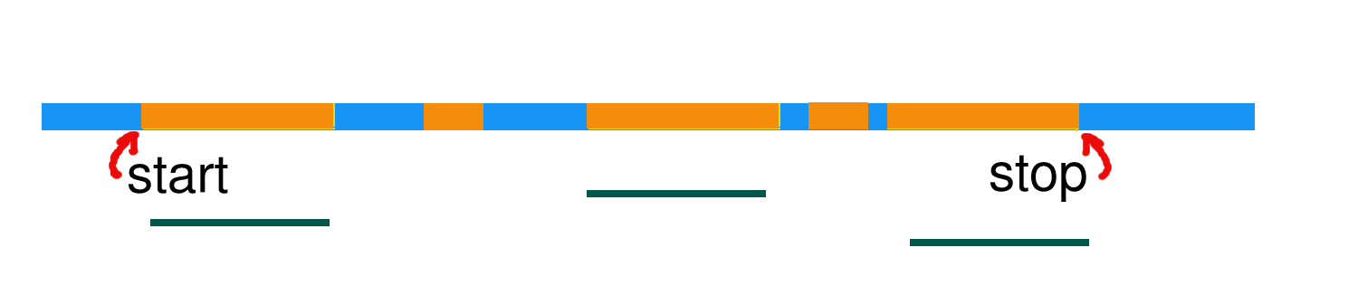
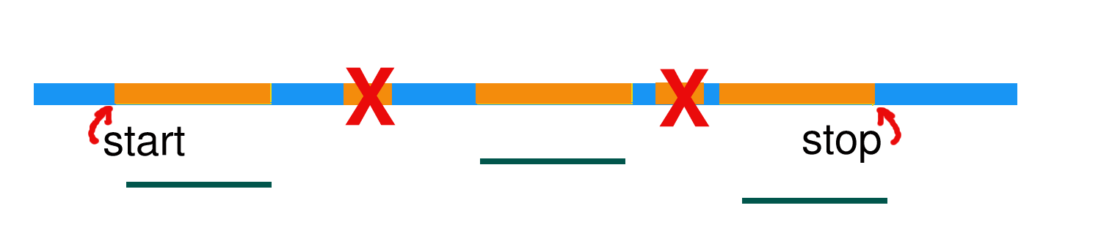
Genie Example
Sequence homology alignments:
Corrected prediction:

Slide 44
Genie
Advantages:
Extraneous predicted exons can be eliminated based on evidence from homology searches.
Likelihood scores provided for each predicted exon.
Disadvantages:
No organism-specific training is possible.
Works best on mammalian genomes, not other eukaryotes.
Reliance on homology evidence can result in oversight of novel genes unique to the organism of interest.

Slide 45
Fgenes
Approach
Identifies putative exons and introns.
Scores each exon and intron based on composition.
Uses dynamic programming to find the highest scoring path through these exons and introns.
The best-scoring path is constrained by several factors including that exons must be in frame with each other and ordered sequentially.

Slide 46
Fgenes
Output
Gene structure derived from best path through putative exons and introns.
Alternative structures with high scores.
Fgenes is about 70% accurate in most mammalian genomes.

Slide 47
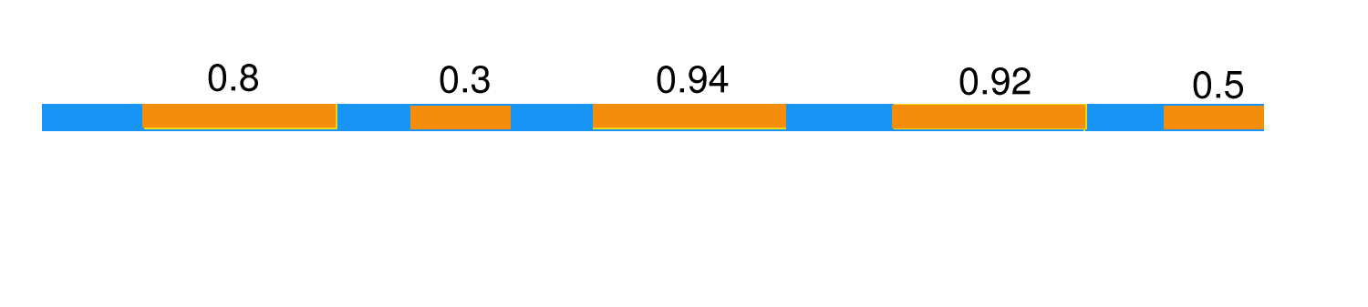
Fgenes Example
Actual gene structure:
Initial predicted exons and scores:

Slide 48
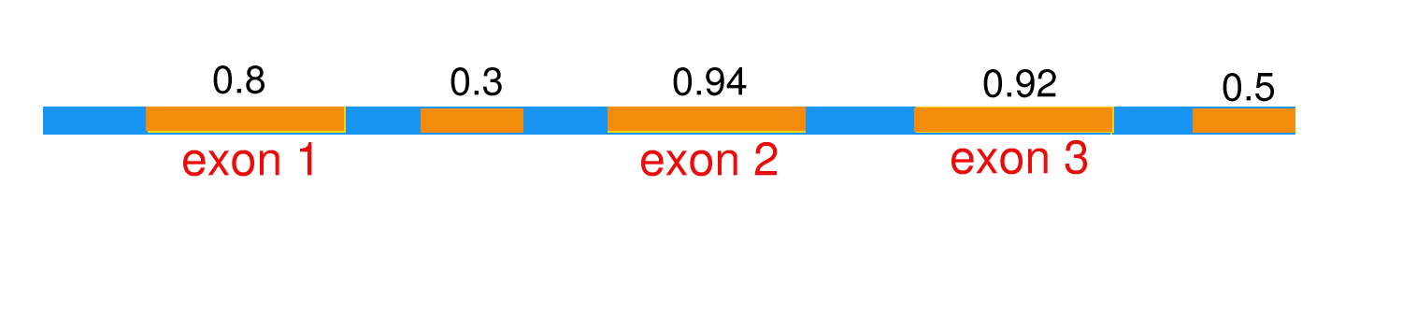
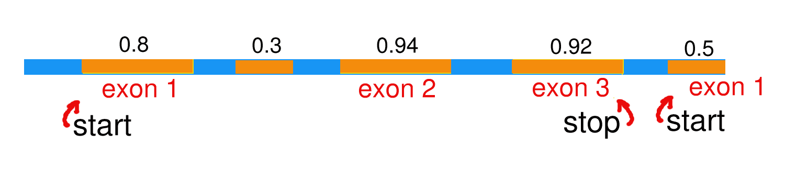
Fgenes Example
Initial gene structure prediction:
Final gene structure prediction:

Slide 49
Fgenes
Advantages:
Alternative gene structures are reported.
Also attempts to identify putative promoter and poly-A sites.
Disadvantages:
User cannot train models.
Only human model-based version is available for unrestricted public use.

Slide 50
Genscan
Approach
Models for different states (GHMMs)
State 1 and 2: Exons and Introns
Length
Composition
State 3: Splice junctions
Weight matrix based array to identify consensus sequences
Weight matrix to identify promoters, poly-A signals and other features.

Slide 51
Genscan
Output
Gene structure
Promoter site
Translation initiation exon
Internal exons
Terminal exon (translation termination)
Poly-adenylation site
Genscan is 80% accurate on human sequences.

Slide 52
Genscan
Advantages:
Most accurate of available tools.
Excellent at identifying internal and terminal exons
Provides some assistance in identifying putative promoters
Disadvantages:
User cannot train models nor tweak parameters.
Identification of initial exons is weaker than other kinds of exons.
Promoter identification can be mis-leading.

Slide 53
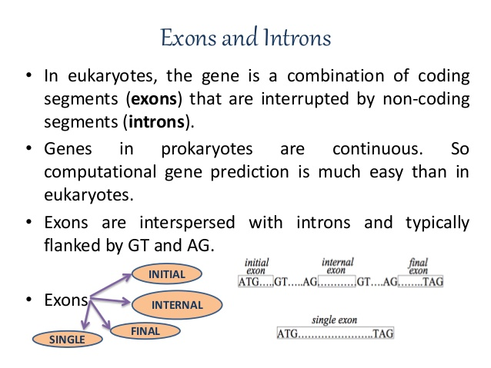

Slide 54
Signals: Pre-mRNA Splicing
Start codon
Stop codon
Genomic DNA
Transcription
pre-mRNA
Cap-
-Poly(A)
Splicing
mRNA
Cap-
-Poly(A)
Translation
Protein
exon
intron
GT AG
Donor site
Acceptor site
Splice sites

Slide 55
Brendel - Spliced Alignment I:
Compare with cDNA or EST probes
Start codon
Stop codon
Genomic DNA
Start codon
Stop codon
mRNA
Cap-
-Poly(A)
5’-UTR
3’-UTR

Slide 56
Brendel - Spliced Alignment II:
Compare with protein probes
Start codon
Stop codon
Genomic DNA
Protein

Slide 57
Brendel Spliced Alignment Algorithm
Perform pairwise alignment with large gaps in one sequence (introns)
Align genomic DNA with cDNA, EST or protein
Score semi-conserved sequences at splice junctions
Score coding constraints in translated exons

Slide 58
Summary for Eukaryote Gene Finding
Eukaryotic gene structures can be quite complex.
The best approaches to gene finding in eukaryotes combine probabilistic methods with heuristics to yield reasonable accuracy.
But even in the best case scenario, accuracy is only about 80%.

Slide 59
References:
http://igs-server.cnrsmrs. fr/igs/banbury/
https://www.ncbi.nlm.nih.gov/pubmed/14764557
https://www.ncbi.nlm.nih.gov/pubmed/10764574
NCBI http://www.ncbi.nlm.nih.gov
TIGR http://www.tigr.org
Sanger Institute http://www.sanger.ac.uk

